Slide 1
Chapter 1
Computer Abstractions and Technology
Lesson 3: More on Performance

Slide 2
Today
More on Performance
Power Trend
Integrated Technology
Amdhal’s Law
MIPS … and MIPS!
Remember: HW1 has been already issued!

Slide 3
Review
Performance = 1/Execution Time
Response time - How long it takes to do a task (it includes disk access, memory access, I/O activities, operating systems overhead, etc)
Aka …. execution time, or elapsed time
Throughput - Total work done per unit time
(aka bandwidth)
CPU time - the time spent by the CPU to complete his task (doesn't include I/O or time spent running other program)
system CPU time - time spent in OS tasks on behalf of a program;
user CPU time (also called CPU performance or CPU execution time) - time spent by the CPU in a program itself

Slide 4
Review (cont.)
Clock cycles - the discrete time interval in which events take place in the hardware
Aka tick, clock tick, clock, cycles
Clock period = length of a clock cycle
Clock frequency - number of cycles per second
aka clock rate
measured in Hertz

Slide 5
CPI Example
Computer A: ClockCycle Time = 250ps, CPI = 2.0
Computer B: ClockCycle Time = 500ps, CPI = 1.2
Same ISA (Instruction Set Architecture)
Which is faster, and by how much?
A is …
…1.2 times as fast as B

Slide 6
CPI in More Detail
If different instruction classes take different numbers of cycles
Weighted average CPI
Relative frequency

Slide 7
Performance Summary
The BIG Picture
Performance depends on
Algorithm: affects IC, possibly CPI
Programming language: affects IC, CPI
Compiler: affects IC, CPI
Instruction set architecture: affects IC, CPI, T_{c}

Slide 8
CPI Example
Alternative compiled code sequences using instructions in classes A, B, C
Class | A | B | C
CPI for class | 1 | 2 | 3
IC in sequence 1 | 2 | 1 | 2
IC in sequence 2 | 4 | 1 | 1
Sequence 1: IC = 5
Clock Cycles = 2×1 + 1×2 + 2×3 = 10
Avg. CPI = 10/5 = 2.0
Sequence 2: IC = 6
Clock Cycles = 4×1 + 1×2 + 1×3 = 9
Avg. CPI = 9/6 = 1.5
Sequence 2 is faster even though it uses more instructions

Slide 9
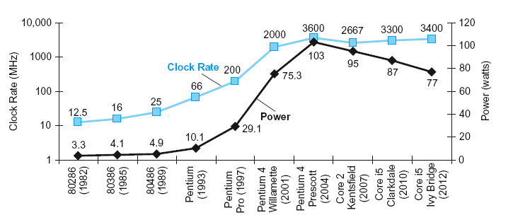
Power Trends
§1.5 The Power Wall
In CMOS Integrated Circuit (IC) technology
CMOS (Complementary Metal Oxide Semiconductor)
5V → 1V
×30
×1000

Slide 10
Reducing Power
Suppose a new CPU has
85% of capacitive load of old CPU
15% voltage and 15% frequency reduction
The power wall
We can’t reduce voltage further
We can’t remove more heat
How else can we improve performance?

Slide 11
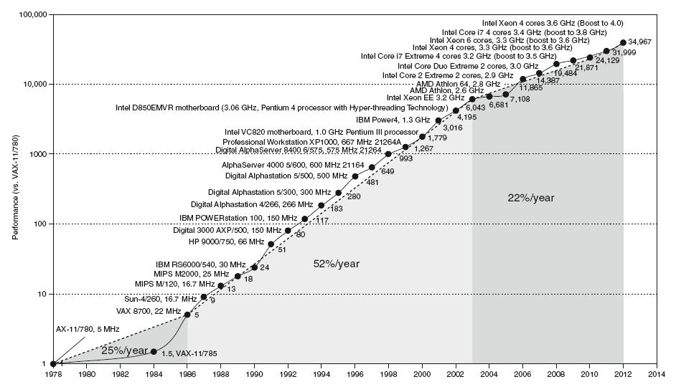
Uniprocessor Performance
§1.8 The Sea Change: The Switch to Multiprocessors
Constrained by power, instruction-level parallelism, memory latency

Slide 12
Multiprocessors
Multicore microprocessors
More than one processor per chip
Requires explicitly parallel programming
Compare with instruction level parallelism
Hardware executes multiple instructions at once
Hidden from the programmer
Hard to do
Programming for performance
Load balancing
Optimizing communication and synchronization

Slide 13
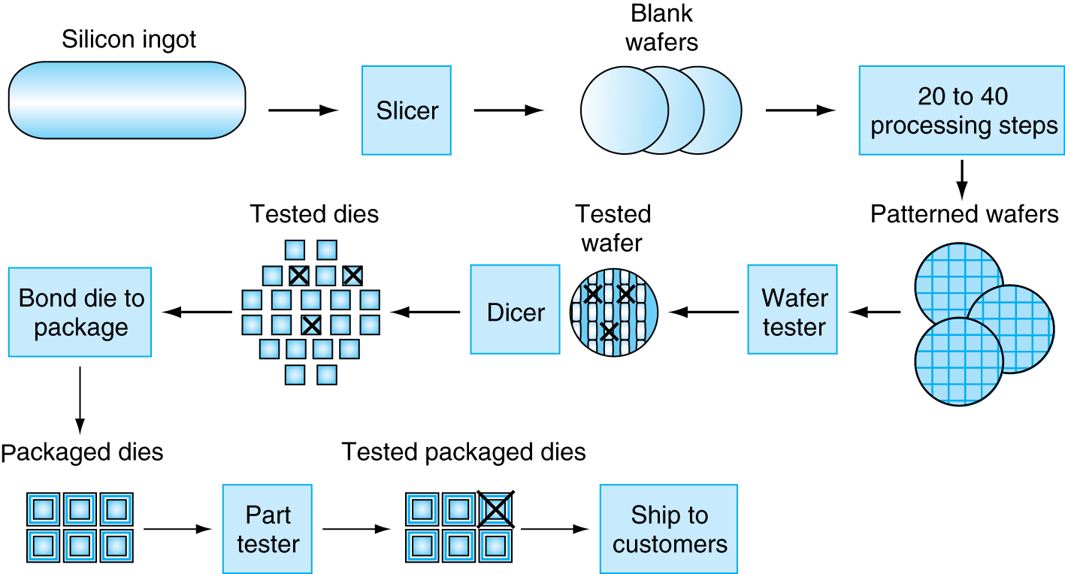
Manufacturing ICs
Yield: proportion of working dies per wafer

Slide 14
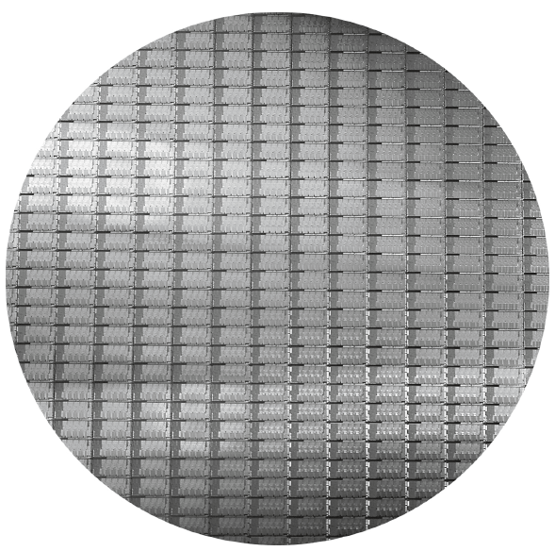
Intel Core i7 Wafer
300mm wafer, 280 chips, 32nm technology
Each chip is 20.7 x 10.5 mm

Slide 15
Integrated Circuit Cost
Nonlinear relation to area and defect rate
Wafer cost and area are fixed
Defect rate determined by manufacturing process
Die area determined by architecture and circuit design

Slide 16
Concluding Remarks
Cost/performance is improving
Due to underlying technology development
Hierarchical layers of abstraction
In both hardware and software
Instruction set architecture
The hardware/software interface
Execution time: the best performance measure
Power is a limiting factor
Use parallelism to improve performance
§1.9 Concluding Remarks

Slide 17
Improving Performance - Amdahl’s Law
Pitfall: Improving an aspect of a computer and expecting a proportional improvement in overall performance
§1.10 Fallacies and Pitfalls
Example:
"Suppose a program runs in 100 seconds on a machine, with multiply responsible for 80 seconds of this time.
How much do we have to improve the speed of multiplication if we want the program to run 4 times faster?“

Slide 18
Amdahl's Law
To be 4 times faster the program should run in 100/4 seconds (i.e. 25 seconds)
25s = (80s / n) + 20s ➔ n = 80/5 = 16s
i.e. the multiplication should run in 16 seconds.
How about making it 5 times faster?
20sec = 20sec + (80sec / n) impossible!!!!
Principle: Make the common case fast

Slide 19
Remember
Performance is specific to a particular program/s
Total execution time is a consistent summary of performance
For a given architecture performance increases come from:
increases in clock rate (without adverse CPI affects)
improvements in processor organization that lower CPI
compiler enhancements that lower CPI and/or instruction count
Algorithm/Language choices that affect instruction count
Pitfall: expecting improvement in one aspect of a machine’s performance to affect the total performance

Slide 20
Pitfall: MIPS as a Performance Metric
MIPS: Millions of Instructions Per Second
Doesn’t account for
Differences in ISAs between computers
Differences in complexity between instructions
CPI varies between programs on a given CPU

Slide 21
Next Lecture and Reminders
Next lecture
MIPS NOT as millions of Instructions per second
MIPS-32 and 64 instruction Set
Reading assignment – PH, The entire Chapter 1
Reminders
HW1 has been assigned and it due this week
HW2 will be show up on Thursday

